Slide 1


NgRx for dummies
Help, my colleague wants state management!

Slide 2
Who am I?
Wouter Van Gorp
5 years @Ordina
1 year @L&V, Team Cuba
Frontend / Full stack developer
Wouter.vangorp@lv.vlaanderen.be

Slide 3


Who am I?
Wouter Van Gorp
5 years @Ordina
1 year @L&V, Team Cuba
Frontend / Full stack developer
Wouter.vangorp@lv.vlaanderen.be

Slide 4
Problem
I freaking hate prop drilling!

Slide 5
Problem
Root Comp.
Service 1
Comp. 1
Comp.
2
Comp.3
Comp.
4
Comp.
5
Comp.
6
Comp.
7

Slide 6
Problem
Root Comp.
Service 1
Comp. 1
Comp.
2
I want persons
Comp.3
Comp.
4
Comp.
5
Comp.
6
Comp.
7

Slide 7
Problem
Root Comp.
Service 1
Comp. 1
Comp.
2
Persons
Comp.3
Comp.
4
Comp.
5
Comp.
6
Comp.
7

Slide 8
Problem
Root Comp.
Service 1
Comp. 1
Comp.
2
Persons
Comp.3
Comp.
4
Comp.
5
I want persons
Comp.
6
Comp.
7

Slide 9
Problem
Root Comp.
Service 1
P’
Comp. 1
Comp.
2
Persons
Comp.3
Comp.
4
Comp.
5
I want persons
Comp.
6
Comp.
7

Slide 10
Problem
P’
Root Comp.
Service 1
Comp. 1
Comp.
2
Persons
Comp.3
Comp.
4
Comp.
5
I want persons
Comp.
6
Comp.
7

Slide 11
Problem
Root Comp.
Service 1
P’
Comp. 1
Comp.
2
Persons
Comp.3
Comp.
4
Comp.
5
I want persons
Comp.
6
Comp.
7

Slide 12
Problem
Root Comp.
Service 1
Comp. 1
Comp.
2
Persons
P’
Comp.3
Comp.
4
Comp.
5
I want persons
Comp.
6
Comp.
7

Slide 13
Problem
Root Comp.
Service 1
Comp. 1
Comp.
2
Persons
Comp.3
Comp.
4
Comp.
5
P’
Comp.
6
Comp.
7

Slide 14
Problem
Root Comp.
Service 1
Comp. 1
Comp.
2
Persons
Comp.3
Comp.
4
Comp.
5
Cars
P’
Comp.
6
Comp.
7

Slide 15
Problem
Root Comp.
Service 1
Comp. 1
Comp.
2
Persons
Comp.3
Comp.
4
Comp.
5
I need cars
Cars
P’
Comp.
6
Comp.
7

Slide 16
Problem
Root Comp.
Service 1
Comp. 1
Comp.
2
Persons
C’
Comp.3
Comp.
4
Comp.
5
Cars
P’
Comp.
6
Comp.
7

Slide 17
Problem
Root Comp.
Service 1
I changed Cars
I want books
Comp. 1
Comp.
2
Persons
C’
Comp.3
Comp.
4
Comp.
5
Cars
P’
Comp.
6
Comp.
7

Slide 18
Problem
Root Comp.
Service 1
I changed Cars
I want books
Comp. 1
Comp.
2
Persons
C’
Comp.3
Comp.
4
Comp.
5
What a struggle!
Is there no easier way?
Cars
P’
Comp.
6
Comp.
7

Slide 19
Problem
State gets divided over several components.
Components can become really complex
Sharing state can become a real struggle
Sins against the unidirectional data flow of angular
Expression changed Error

Slide 20


Slide 21
Solution
If only something could help us…

Slide 22



Solution
State management!
NgRx
NgXs
Akita
NgRx Docs: https://ngrx.io/docs

Slide 23
Solution: NgRx
NgRx is a framework for building reactive applications in Angular. NgRx provides libraries for:
Managing global and local state.
Isolation of side effects to promote a cleaner component architecture.
…
NgRx Docs: https://ngrx.io/docs

Slide 24
Solution: NgRx
NgRx is a framework for building reactive applications in Angular. NgRx provides libraries for:
Managing global and local state.
Isolation of side effects to promote a cleaner component architecture.
…
It’s like a database for the frontend.
NgRx Docs: https://ngrx.io/docs

Slide 25


Slide 26
Solution
Root Comp.
Service 1
Comp. 1
Comp.
2
Comp.3
Comp.
4
Comp.
5
Store
Comp.
6
Comp.
7

Slide 27
Solution
Root Comp.
Service 1
Comp. 1
Comp.
2
I want persons
Comp.3
Comp.
4
Comp.
5
Store
Comp.
6
Comp.
7

Slide 28
Solution
Root Comp.
Service 1
Comp. 1
Comp.
2
I want persons
Comp.3
Comp.
4
Comp.
5
Persons
Store
Comp.
6
Comp.
7

Slide 29
Solution
Root Comp.
Service 1
Comp. 1
Comp.
2
P’
Comp.3
Comp.
4
Comp.
5
Store
Comp.
6
Comp.
7
Persons

Slide 30
Solution
Root Comp.
Service 1
Comp. 1
Comp.
2
P’
Comp.3
Comp.
4
Comp.
5
I want persons
Store
Comp.
6
Comp.
7
Persons

Slide 31
Solution
Root Comp.
Service 1
Comp. 1
Comp.
2
P’
Comp.3
Comp.
4
Comp.
5
Store
Comp.
6
P’
Comp.
7
Persons

Slide 32
Solution
Root Comp.
Service 1
Comp. 1
Comp.
2
P’
C’
Comp.3
Comp.
4
Comp.
5
C’
Store
Comp.
6
P’
Comp.
7
Persons
Cars

Slide 33
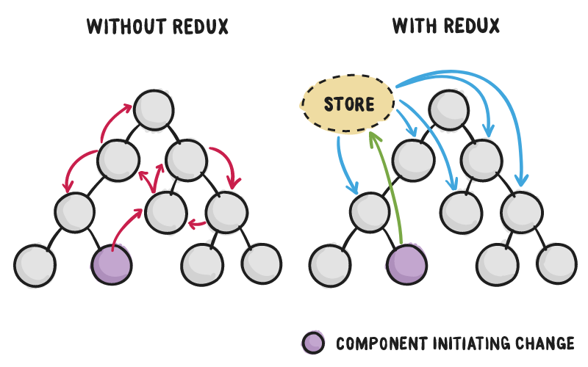
This REDUX thingy looks cool!

Slide 34
Building blocks
Things you need to know before we can start

Slide 35
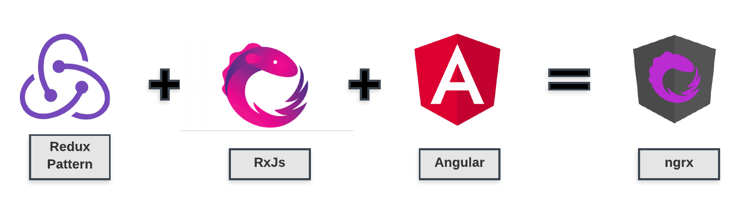
Building blocks

Slide 36
Building blocks: Angular
SMART Component | DUMB component
Has little html | Can have a lot of html
Has services for data (stateful) | Gets data through inputs (stateless)
Contains logic | Display only, NO LOGIC ALLOWED
Reacts on events from childs | Throws events to parent
Be smart and make components DUMB!

Slide 37
Building blocks: RxJs
RxJS is a library for reactive programming using Observables, to make it easier to compose asynchronous or callback-based code.
https://rxjs.dev/

Slide 38


Building blocks: RxJs
Hot observable:
1 subscription for all subscribers (multicast)
Does not wait for subscribers to emit (eager)
E.g. Router params
Cold observable:
1 subscription per subscriber (unicast)
Only emits when there is a subscription (lazy)
E.g. http call

Slide 39
Building blocks: RxJs
of(3)
Creates an observable that emits given value.
first()
emits the first value only, after this the observable will complete.
filter(x => x > 2)
Allows you to prevent values from being emitted based upon a supplied function.
map(x => x + 2)
Allows the values to be modified to a new value.

Slide 40
Building blocks: RxJs
withLatestFrom(obs1$)
Adds the latest value from another observable to the result
Returns [val0, val1]
switchMap(x => getData(x))
Allows for emitting values from an operation that creates a separate observable.
Use this when you only care about the most recent parent emit
https://rxmarbles.com/

Slide 41
Building blocks: Redux
Redux is a predictable state container for javascript applications.
The three Principles of Redux:
Single source of truth (Store)
State is immutable (read-only)
Pure functions only
Notes:
The three Principles of Redux:
Single source of truth(Store): The state of the application should be stored in a single store. The store is the responsible for providing data to the components.
State is read-only: The state is read-only or Immutable that means if you want to update the state, new action should be emitted.
Pure function reducers: The function return values are identical for identical arguments (no variation with local static variables, non-local variables, mutable reference arguments or input streams).
Reducers are pure functions that takes a previous state and an action, and return a new state. They don’t modify the existing state, instead they return a new one.

Slide 42
REDUX: State is immutable
In object-oriented and functional programming, an immutable object (unchangeable object) is an object whose state cannot be modified after it is created.
https://en.wikipedia.org/wiki/Immutable_object
If state is immutable, then how do I update it?
Notes:
De store is immutable, de enige manier om de state aan te passen is door een nieuwe state aan te maken!

Slide 43
REDUX: Pure functions?
PURE | IMPURE
Always produces the same result when given the same arguments. | May produce different results when given the same arguments.
Never have side effects. | May have side effects.
Never alter state. | May alter global state of the program
function add(x, y) { return x + y; } | var count = 3; function add(x) { count = counter + x; return count + x; }
Side effects make functions unpredictable

Slide 44
Setup NgRx
Finally!

Slide 45
Setup NgRx
npm install @ngrx/store
This is the store itself
npm install @ngrx/effects
This we will use to fetch data from the backend
npm install @ngrx/store-devtools
This is to help our development process

Slide 46
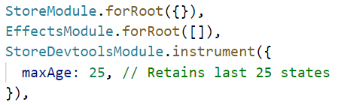
Setup NgRx: App module

Slide 47
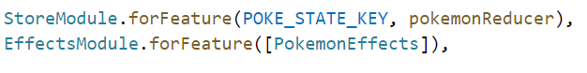
Setup NgRx: Feature module

Slide 48
Core concepts
Show me the co….de baby.

Slide 49

Core concepts
STATE
SELECTORS
ACTIONS
REDUCERS
EFFECTS

Slide 50
Core concepts: State
Defines the interface of your state
Defines the default values of your state

Slide 51
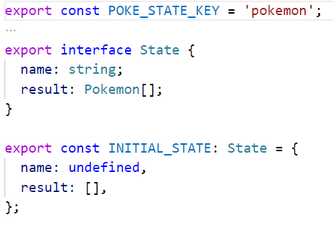
Core concepts: State

Slide 52
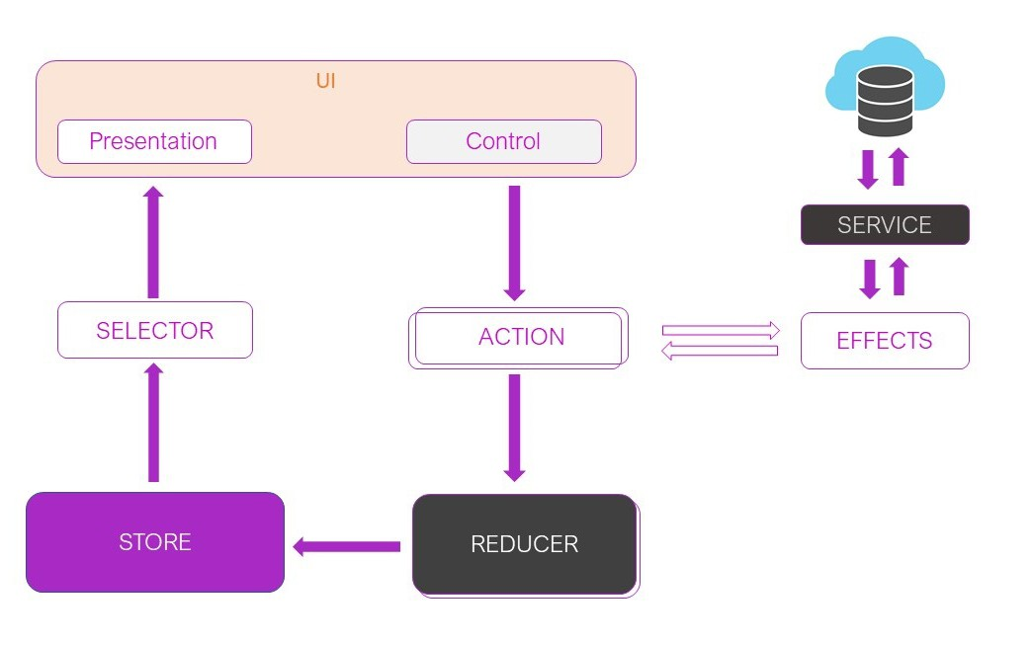

Core concepts: Store

Slide 53
Core concepts: Selectors
Defines getters on your state
Returns slices of store state as an observable
When your state changes, components update automatically.
Store observables
=
HOT observables

Slide 54
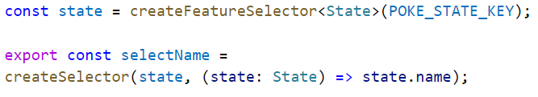
Core concepts: Selectors

Slide 55
Core concepts: Selectors

Slide 56
Core concepts: Actions
Define actions that you want to happen on your state
E.g. Load persons
Defines pure functions that handle state changes
Make sure that you define actions. NOT events.

Slide 57
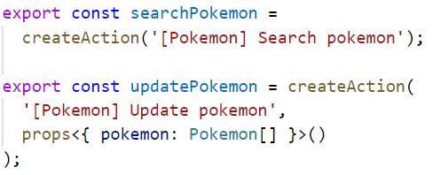
Core concepts: Actions

Slide 58
Core concepts: Actions

Slide 59
Core concepts: Reducer
Defines pure functions that handle state changes
Always returns a new state
Pure functions,
so no side effects!

Slide 60
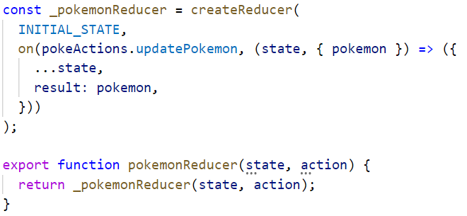
Core concepts: Reducer

Slide 61
Core concepts: Reducer

Slide 62
Core concepts: Effects
Isolates side effects from components
Listens to all triggered actions
A little like an event bus
Perform synchronous or asynchronous tasks based on actions
Always returns a new action

Slide 63
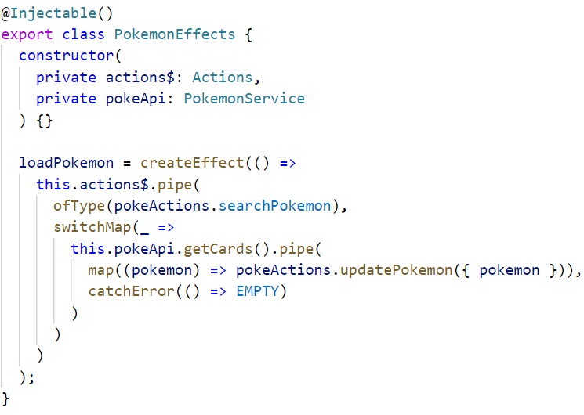
Core concepts: Effects

Slide 64
Core concepts: Effects

Slide 65
CODING TIME

